Slide 1


ALTSCHOOL OF Cybersecurity (BARAKA 2025)
MONTH 3 – WEEK 3

Slide 2
Refresher- week2
Network Security
Introduction to Network Security
Types of Threats to Network Security
Introduction to Firewall and IDS/IPS
Virtual Private Networks (VPNs)
Network Security Best Practices
Setting Up VLans
Configuring VLans and Network Security
Setting up VLans in Cisco Packet Tracer
Setting up basic firewall rules

Slide 3
MONTH 3 - WEEK 4
Cloud Computing Concepts
Introduction to Cloud Computing
Introduction to Cloud Computing Models (IaaS, SaaS, PaaS)
Benefits and Challenges of Cloud Computing
Cloud Service Providers (AWS, Azure, GCP, Huawei & Oracle)
Cloud Security Basics (Shared Responsibility Model)
Securing Cloud Infrastructure and Data
Compliance in the Cloud
Class Demo and Assignment

Slide 4
Cloud Computing Concepts
Day 1

Slide 5
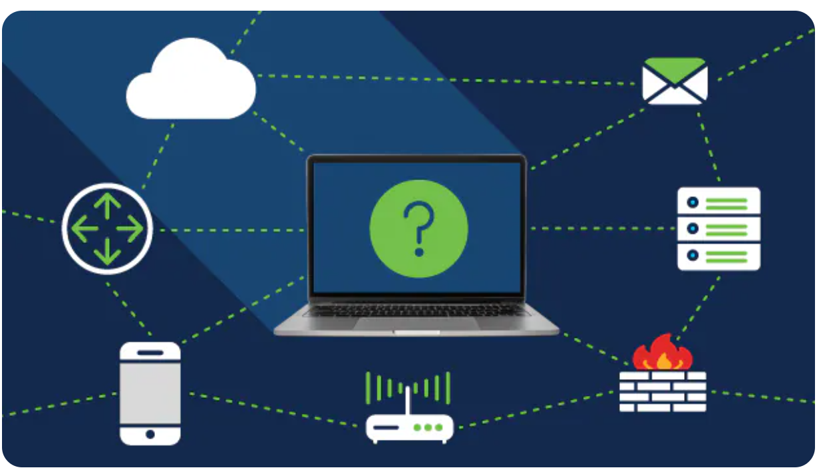
WHAT IS NETWORK SECURITY?
Network security is the protection of the underlying networking infrastructure from unauthorized access, misuse, or theft. It involves creating a secure infrastructure for devices, applications, users, and applications to work in a secure manner.
Network security also refers to the technologies, policies, people, and procedures that defend any communication infrastructure from cyberattacks, unauthorized access, and data loss. In addition to the network itself, they also secure traffic and network-accessible assets at both the network edge and inside the perimeter.

Slide 6
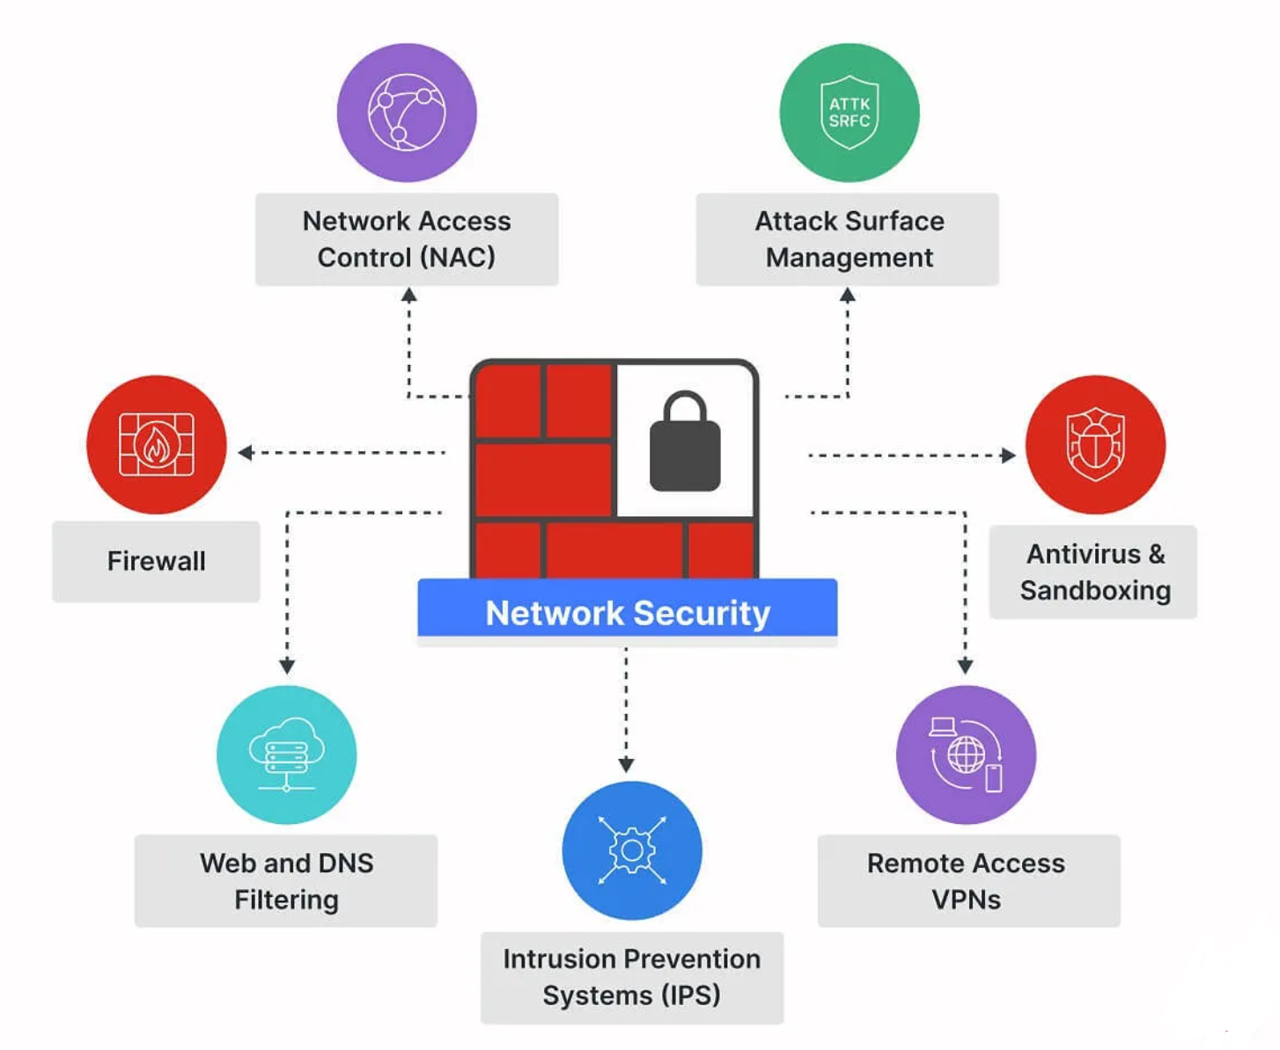
HOW NETWORK SECURITY WORKS…
Network security combines multiple layers of defenses at the edge and in the network. Each network security layer implements policies and controls. Authorized users gain access to network resources, but malicious actors are blocked from carrying out exploits and threats.

Slide 7
HOW NETWORK SECURITY WORKS…
Digital acceleration paved the way for business efficiencies, cost reductions, and productivity improvements. Yet, it has also led to an expanded attack surface across the growing network edge. From local area networks (LAN) and wide area networks (WAN) to the Internet of Things (IoT) and cloud computing, each new deployment results in another potential vulnerability.

Slide 8
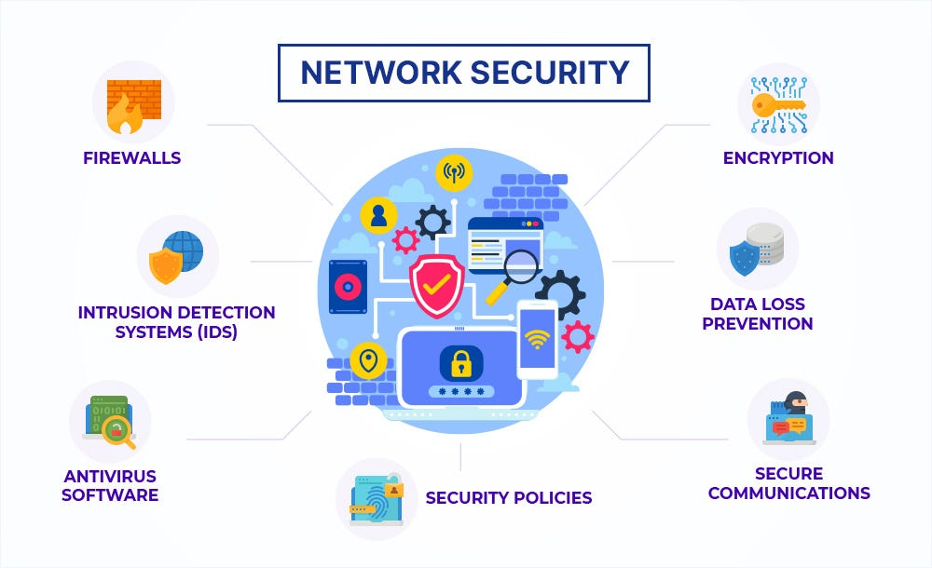
WHY NETWORK SECURITY IS IMPORTANT…
Network security is crucial for protecting sensitive data and maintaining the integrity and functionality of computer networks. Without adequate network security measures, organizations face a range of risks including data breaches, financial losses, and reputational damage. Ensuring network security helps in:
Preventing unauthorized access: Network security protocols protect networks from unauthorized access, ensuring only legitimate users can access critical systems and data.
Protecting data integrity: Network security measures prevent data tampering and ensure the accuracy and reliability of data. This is particularly important for organizations handling sensitive information such as financial data, personal records, and intellectual property.

Slide 9
WHY NETWORK SECURITY IS IMPORTANT…CONT’D
Ensuring business continuity: Cyberattacks such as DDoS attacks can disrupt business operations. Effective network security strategies help in mitigating these risks, ensuring continuous availability of services and operations.
Compliance with regulations: Many industries are subject to regulatory requirements mandating strict data protection measures. Network security helps organizations comply with standards like GDPR, HIPAA, and PCI-DSS, avoiding legal penalties and maintaining customer trust.
Mitigating financial losses: Cyber incidents can result in significant financial losses due to data theft, ransom payments, and business disruptions. Implementing network security can help in reducing these potential losses by preventing or quickly responding to incidents.

Slide 10
NETWORK SECURITY THREATS
Day 1

Slide 11

NETWORK SECURITY THREATS - MALWARE
Malware is a program that attacks information systems. There are various types of malware, each designed to perform specific malicious activities. For example, ransomware encrypts files and holds it for ransom, spyware covertly spies on victims, and Trojans infiltrate systems.
Threat actors use malware to achieve various objectives, such as stealing or secretly copying sensitive data, blocking access to files, disrupting system operations, or making systems inoperable.

Slide 12

NETWORK SECURITY THREATS - PHISHING
Phishing is a type of fraud that occurs when a threat actor impersonates a reputable entity in person, via email, or other communication forms. Threat actors often use phishing emails to spread malicious attachments or links that perform various functions, such as extracting the victim’s account information or login credentials.

Slide 13
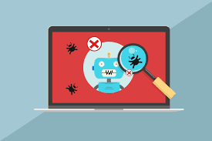
NETWORK SECURITY THREATS - BOTS
A bot is a small program that automates web requests with various goals. Bots perform their tasks without any human intervention, for example, scanning website content and testing stolen credit card numbers.
A bot attack utilizes automated web requests to defraud, manipulate, or disrupt applications, websites, end-users, or APIs. Bot attacks were originally used primarily for spam and denial of service, but have evolved into complex enterprises with economies and infrastructure that enables waging additional, more damaging attacks.

Slide 14

NETWORK SECURITY THREATS - DDoS
A Distributed Denial of Service (DDoS) attack employs multiple compromised computer systems to attack a target and cause a denial of service for the targeted resource’s users. It sends a flood of messages, malformed packets, or connection requests to the target system, forcing it to slow down or entirely shut down, denying service to real systems and users. DDoS attacks can target a website, server, and other network resources.

Slide 15

NETWORK SECURITY THREATS – APT
An advanced persistent threat (APT) is a targeted and prolonged attack during which intruders gain unauthorized access to a network, remaining undetected for an extended time. Threat actors usually launch APT attacks to steal data rather than cause damage to the target’s network.
Most APT attacks aim to obtain and maintain long-term, covert access to a targeted network. Since it is not a simple operation involving getting in and out as quickly as possible, APT attacks typically require much effort and resources. To ensure a return on investment, actors choose high-value targets like large corporations and nation-states.

Slide 16
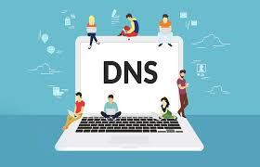
NETWORK SECURITY THREATS – DNS ATTACK
A DNS attack occurs when a threat actor exploits vulnerabilities in a domain name system (DNS). DNS was designed for usability rather than security. As a result, threat actors can exploit the communication between clients and servers to launch attacks.
Threat actors often exploit the plaintext communication between clients and DNS servers. Another attack strategy involves logging in to a DNS provider’s website using stolen credentials and redirecting DNS records.

Slide 17
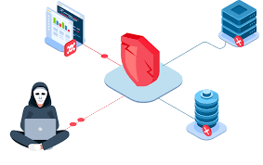
NETWORK SECURITY THREATS – Misconfiguration Exploits
Misconfiguration exploits occur when network systems, applications, or devices are improperly configured, leading to vulnerabilities that threat actors can exploit. Common sources of misconfigurations include default settings, lack of timely updates, and human error.
For example, many devices and applications come with default settings that are often insecure. If these defaults are not changed, networks remain open to attacks. Additionally, systems that are not regularly updated and patched are left exposed to exploits targeting known vulnerabilities.

Slide 18
NETWORK SECURITY THREATS – Misconfiguration Exploits
Exposed services and insufficient access controls also contribute to misconfiguration risks. Unnecessary services or open ports can provide additional entry points for attackers, making proper network segmentation and minimizing the attack surface critical for security. Weak access control measures, such as overly permissive permissions or lack of multi-factor authentication, allow unauthorized users to gain access to sensitive systems and data.

Slide 19
INTRODUCTION TO FIREWALLS & IDS/IPS
Day 1

Slide 20

FIREWALLS
A firewall controls inbound and outbound traffic on networks using predetermined security rules to prevent malicious traffic from entering the network. Network security relies on firewalls to protect against external threats. Today, most organizations use next-generation firewalls (NGFW) that can block malware and application-layer attacks

Slide 21

Intrusion Prevention Systems (IPS)
IPS technology detects or prevents network security attacks such as brute force and DoS attacks and exploitation of known vulnerabilities. A security vulnerability can potentially allow threat actors to achieve various malicious goals, like gain control of an affected system. Once an actor discovers a vulnerability, there is a window of opportunity to exploit it before it is discovered and patched. An IPS can help quickly block exploits of known vulnerabilities.

Slide 22

WEB APPLICATION FIREWALL (WAF)
A web application firewall (WAF) is a program that can filter, monitor, and block HTTP traffic flowing to and from a web service. Inspecting HTTP traffic enables a WAF to prevent actors from exploiting known vulnerabilities in web applications, such as cross-site scripting (XSS), SQL injections (SQLi), improper system configuration, and file inclusion..

Slide 23
WEB APPLICATION FIREWALL (WAF)
A WAF is the next logical step after an NGFW. By and large, it provides the same features as NGFW, with these additional capabilities:
Protection against OWASP Top 10 and Automated Top 20 WAF solutions must be able to protect against the most critical web application security threats. Imperva provides protection against the risks detailed in the top 10 threats of Open Web Application Security Project (OWASP) and Automated Top 20 threats including SQL injection, remote file inclusion and cross-site scripting.
Attack detection Accurately detecting attacks while minimizing the number of false positives is essential to ensure that your cybersecurity teams focus efforts on mitigating the most critical threats to systems and networks. Imperva WAF achieves this with high accuracy and blocks malicious traffic by using patented dynamic application profiling and attack validation which learns all aspects of web applications including URLs, parameters and acceptable user inputs and directories. Correlated attack validation allows you to analyze each violation

Slide 24
WEB APPLICATION FIREWALL (WAF)
Extensive reporting WAF solutions should provide broad reports in a straightforward manner so you can easily understand what is happening in your system. This allows you to quickly assess the security status of your applications and demonstrate compliance with standards such as PCI, SOX, HIPAA and FISMA. Imperva WAF can generate rich, predefined and customizable graphical reports to help you meet regulatory compliance and gain a full understanding of your security status.
SIEM integration WAF solutions should integrate Security Information and Event Management (SIEM) tools provided by top vendors such as Splunk and ArcSight. Imperva WAF integrates with the solutions of the leading security SIEM providers to export events such as Syslog messages, JSON format and Common Event Format (CEF). Imperva WAF makes event management simple by indexing them in real-time to make them easily searchable for quick Incident Response (IR).

Slide 25
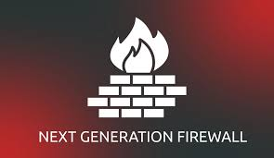
NEXT GENERATION FIREWALLS (NGFWs)
A Next-Generation Firewall (NGFW) is a cyber security solution to protect network fronts with capabilities that extend beyond traditional firewalls. While traditional firewalls detect suspicious traffic and block network access based on a predefined blacklist, NGFWs include additional features such as intrusion prevention and deep packet inspection.

Slide 26
NEXT GENERATION FIREWALLS (NGFWs) - FEATURES
Blocking threats at the network edge Prevents attacks from accessing the network by using sandboxing, URL filtering and analyzing behavior to detect and deal with threats such as malware, ransomware and SQL injection.
Geolocation Correlates between IP address and physical locations to restrict location-based access or direct traffic towards specific servers.
Reverse proxy / web gateway Offers a proxy that terminates connections, including encrypted HTTPS sessions, and forward the content to a web server after inspecting it.
Intrusion Detection and Prevention Systems (IDS/IPS) Detects and prevents system intrusions based on known signatures or generic attack forms to stop known attacks.

Slide 27
VIRTUAL PRIVATE NETWORK
Day 1

Slide 28
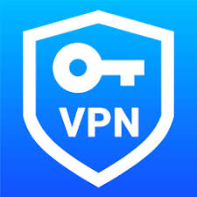
VIRTUAL PRIVATE NETWORK
A virtual private network (VPN) protects users’ identities by masking their IP address and location and encrypting their data. Using a VPN eliminates the need to connect to the Internet directly. Instead, it provides a secure server that connects to the public Internet on behalf of the user.
VPNs help organizations and individuals protect themselves when connecting to unsafe networks like public WiFi connections in airports and coffee shops. It helps protect users from threat actors trying to steal sensitive data like photos, corporate emails, credit card numbers, and users’ identities.

Slide 29
Network Security Best Practices
Day 1

Slide 30

Audit the Network and Security Controls
Auditing the network is essential to obtaining the information needed to assess the organization’s security posture accurately. Here are notable benefits of network audits:
Identifying potential vulnerabilities that require remediation.
Locating unused and unnecessary applications that run in the background.
Determining the firewall’s strength to correct its settings accurately.
Measuring the state of networked servers, software, applications, and gear.
Confirming the efficacy of the overall security infrastructure.
Assessing the status of current server backups.
Organizations must conduct audits regularly and consistently over time.

Slide 31
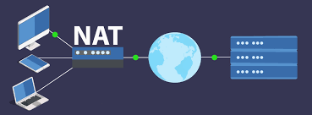
Use Network Address Translation
Network address translation (NAT) helps compensate for the address deficiency of IPv4 networking. It translates private addresses within the organization into routable addresses on a public network like the Internet. Organizations use NAT to connect multiple computers to the public Internet using one IP address.
NAT works alongside firewalls, providing additional protection for internal networks. Hosts inside protected networks with private addresses can usually communicate with the external world. However, systems outside the protected network must go through NAT boxes to reach an internal network. NAT also enables using fewer IP addresses to confuse actors from learning which host they are attacking.

Slide 32
Use Centralized Logging and Immediate Log Analysis
Organizations must record suspicious logins and various computer events to look for anomalies. The goal is to reconstruct what has happened during an existing or past attack to identify the necessary steps to improve the organization’s threat detection process and facilitate a quicker response during future events.
Threat actors often try to avoid logging and detection. For example, an actor can target a sacrificial computer while it actually performs different actions and monitors to learn how the targeted systems work. It helps threat actors learn which thresholds to stay below to avoid triggering security alerts.

Slide 33
Refresher- Day 1
Network Security
Introduction to Network Security
Types of Threats to Network Security
Introduction to Firewall and IDS/IPS
Virtual Private Networks (VPNs)
Network Security Best Practices

Slide 34
MONTH 3 - WEEK 1 (day 2)
Setting Up Vlans – Class Demo
Configuring VLans and Network Security
Setting up VLans in Cisco Packet Tracer
Setting up basic firewall rules

Slide 35
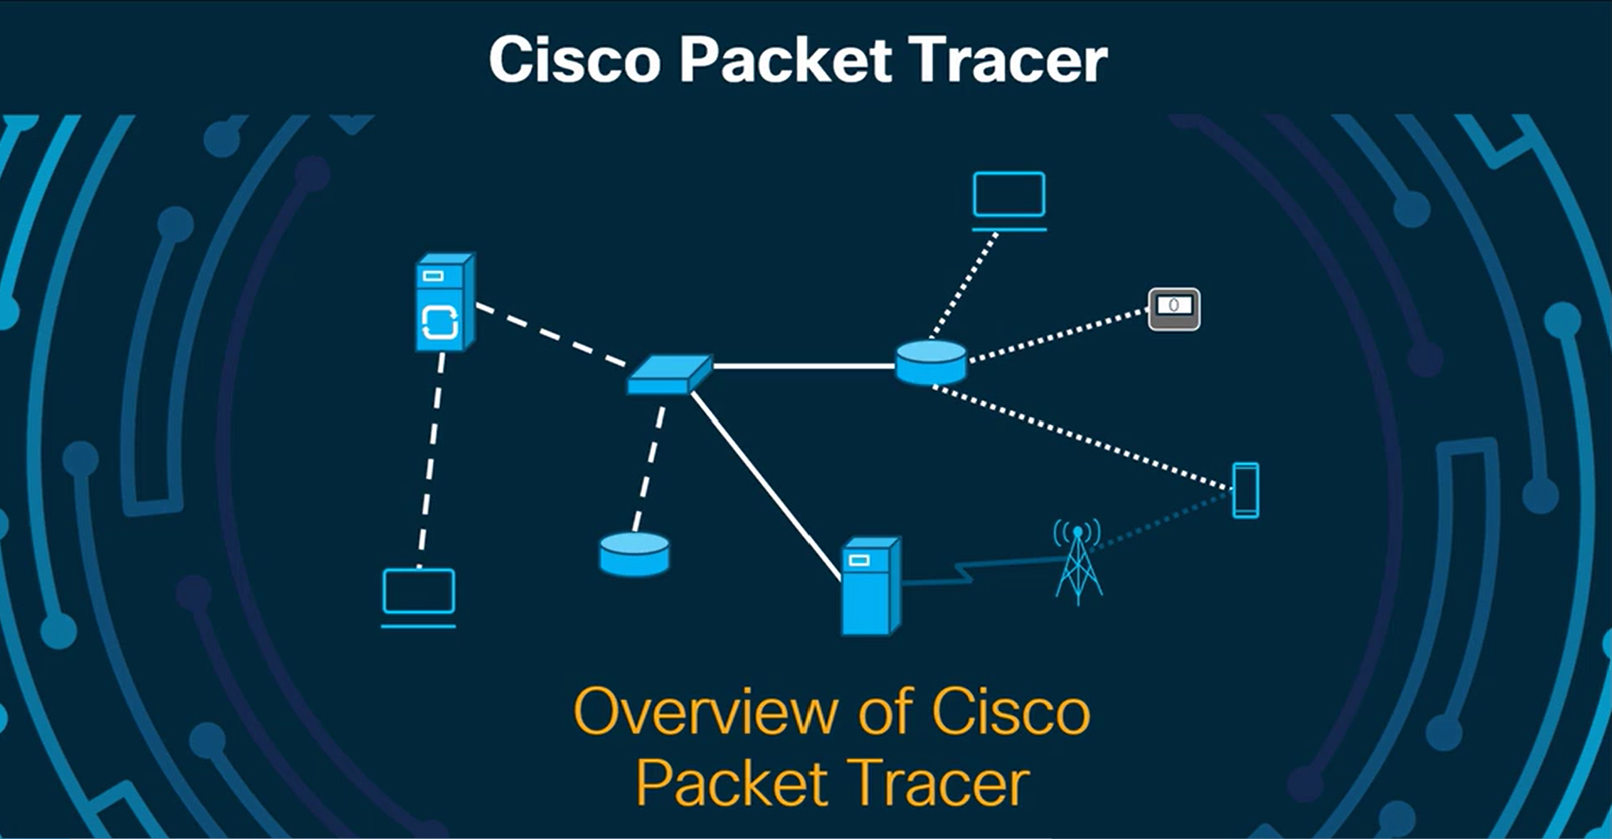
Configuring VLans and Network Security – using cisco packet tracer
https://www.netacad.com/cisco-packet-tracer

Slide 36
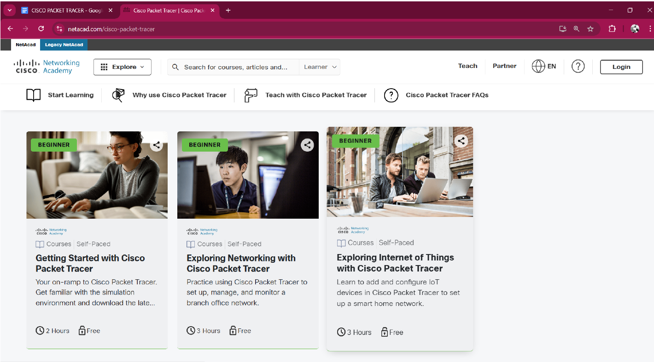
Configuring VLans and Network Security – using cisco packet tracer
Click on the “getting started with cisco packet tracer” and click on the green button. This will ask you to log in or register if you don’t have an account.

Slide 37
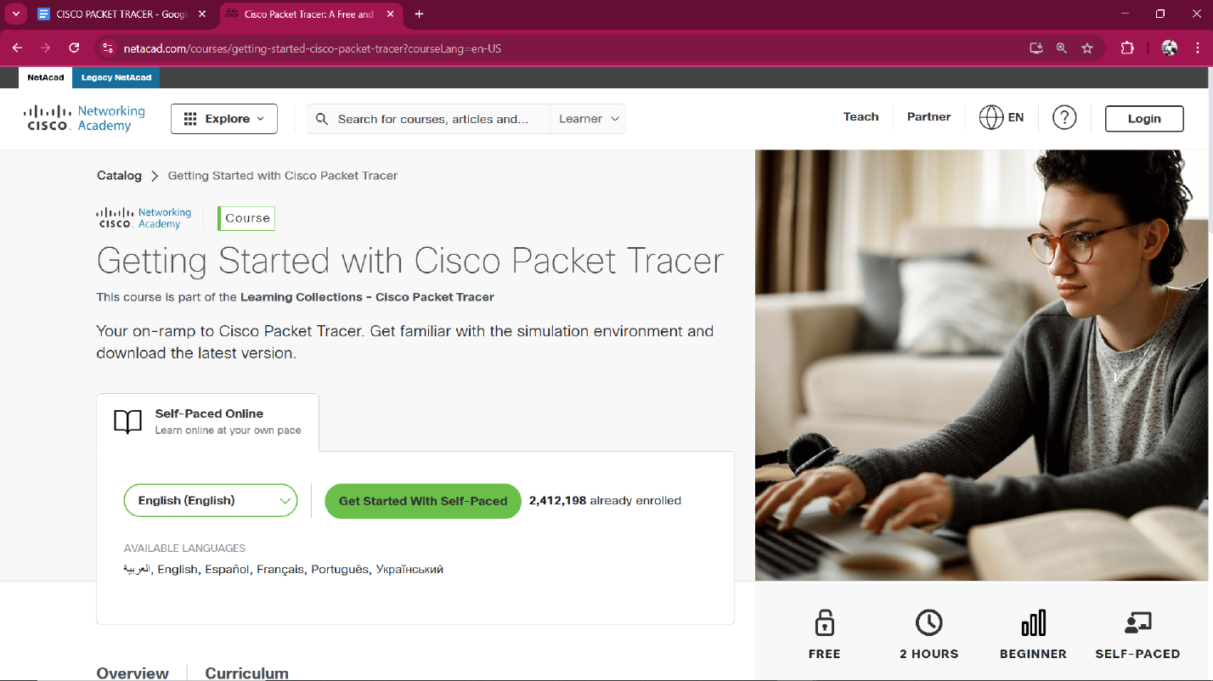
Configuring VLans and Network Security – using cisco packet tracer
https://www.netacad.com/cisco-packet-tracer
Click on the green button - Get started with self pace.

Slide 38
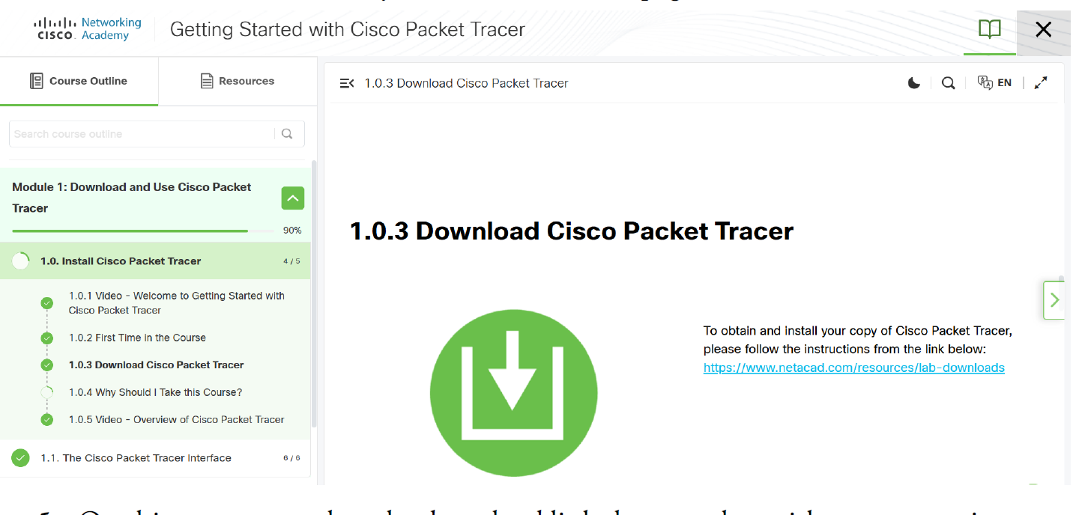
Configuring VLans and Network Security – using cisco packet tracer
https://www.netacad.com/cisco-packet-tracer
Click on the 1.0.3 Module tagged “Download Cisco Packet Tracer” and you will find a link that takes you to the download page. Click this link.

Slide 39
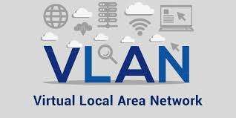
What is a vlan?
VLANs are used to divide a physical LAN into multiple broadcast domains to isolate services with the aim of improving the security and management of the network. Hosts within a VLAN can directly communicate only with other hosts in the same VLAN and must use a router to communicate with hosts in other VLANs.

Slide 40
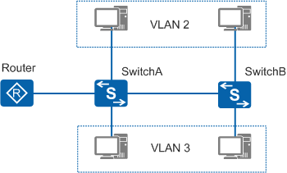
Network topology
In the network shown in Figure, two switches are deployed at different locations, for example, on different floors of an office building. Both switches connect to two computers that belong to different enterprises. In this case, the computers can be assigned to different VLANs, achieving isolation of users between enterprises.

Slide 41
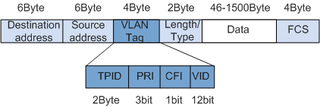
Network tAG
A switch identifies packets from different VLANs according to the information contained in its VLAN tags. IEEE 802.1Q adds a 4-byte VLAN tag between the Source/Destination MAC address and Length/Type fields of an Ethernet frame, as shown in Figure 2.

Slide 42
Network tAG
The VLAN ID (VID) field in a data frame identifies the VLAN to which the data frame belongs (the VLAN in which the data frame can be transmitted). All frames processed on a switch carry VLAN tags, but some devices connected to a switch cannot process tagged frames. To enable communication between the switch and these devices, the switch interfaces must be able to identify whether an Ethernet frame is tagged, and then decide whether to add VLAN tags to or remove VLAN tags from the frames. Hosts in the same VLAN may be connected to different switches, in which case the VLAN spans multiple switches. To enable communication between these hosts, interfaces between switches must be able to identify and send frames of multiple VLANs.

Slide 43
Network Tag - IEEE
Institute of Electrical and Electronics Engineers (IEEE) - is a global professional association dedicated to advancing technology, especially in areas like electrical engineering, electronics, computer science, networking, and telecommunications. They’re the ones who develop important standards like IEEE 802.1Q (VLAN tagging), IEEE 802.11 (Wi-Fi), and many others.
IEEE 802.1Q is the networking standard for VLAN tagging on Ethernet networks. It allows multiple VLANs (Virtual LANs) to coexist on the same physical Ethernet network (or trunk link), by inserting a special tag into Ethernet frames. This tag carries the VLAN ID so that switches and routers can properly segregate and route traffic between VLANs.

Slide 44
CLASS DEMO
192.168.2.2
192.168.2.3
Gateway
192.168.2.1
192.168.3.1
192.168.3.2
192.168.3.3

